Slide 1
Java 8

Slide 2
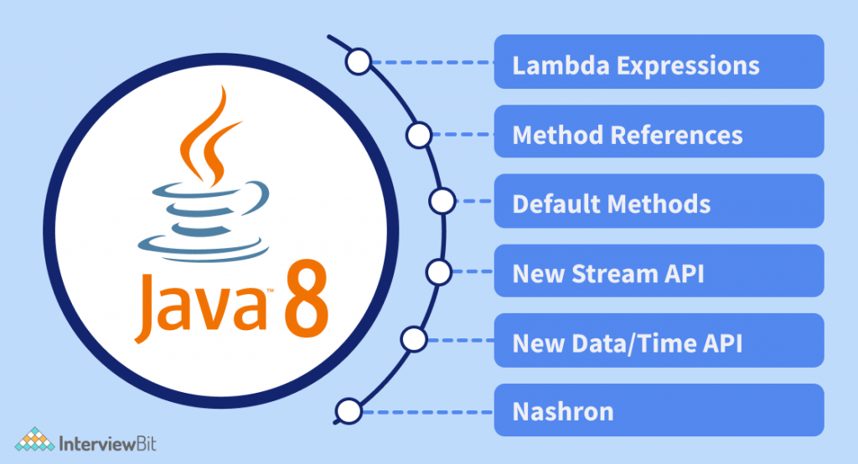

Slide 3
Lambda expressions
A lambda expression is a short block of code which takes in parameters and returns a value.
Lambda expressions are similar to methods, but they do not need a name and they can be implemented right in the body of a method.

Slide 4
Lambda expressions in Java 8
Lambda expressions are instances of functional interfaces.
An interface with single abstract method is called functional interface.
lambda expressions implement the only abstract function and therefore implement functional interfaces.
lambda expressions are added in Java 8 and provide below functionalities.
Enable to treat functionality as a method argument, or code as data.
A function that can be created without belonging to any class.
A lambda expression can be passed around as if it was an object and executed on demand.

Slide 5
Syntax of lambda expressions
The simplest lambda expression contains a single parameter and an expression:
parameter -> expression
To use more than one parameter, wrap them in parentheses:
(parameter1, parameter2) -> expression

Slide 6
Rules of lambda expression
Return Type
When there is a single statement, the return type of the anonymous function is the same as that of the body expression.
When there is more than one statement enclosed in curly brackets then the return type of the anonymous function is the same as the type of the value returned within the code block,
or void if nothing is returned.

Slide 7
Examples
Zero parameter
() -> System.out.println(” No Parameters “);
One Parameter
(parameter) -> System.out.println(“One parameter is : ” + parameter);
or without parenthesis; parameter -> parameter (Identity function example)
Multiple parameters
(parameter1, parameter2) -> parameter1 + parameter2;
Parameter Types
(int a, String name) -> System.out.println(“id:” + a + ” name:” + name);
Code block
(parameter1, parameter2) -> { return parameter1 + parameter2; }

Slide 8
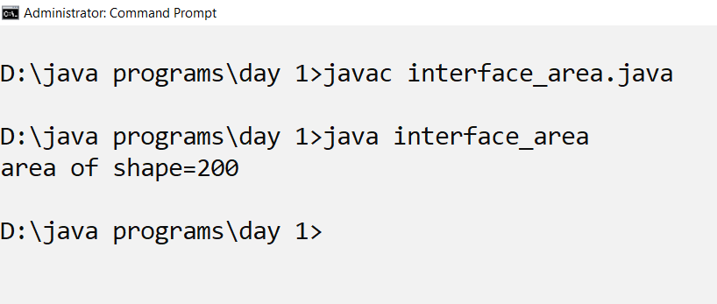
Implementation of area() method from interface shape without lambda
interface shape{
int area(int l,int b);
}
class interface_area implements shape{
public int area(int x,int y){
return x*y;
}
public static void main(String [] args){
int l=10;
int b=20;
shape s=new interface_area();
System.out.println("area of shape="+s.area(l,b));
}
}

Slide 9
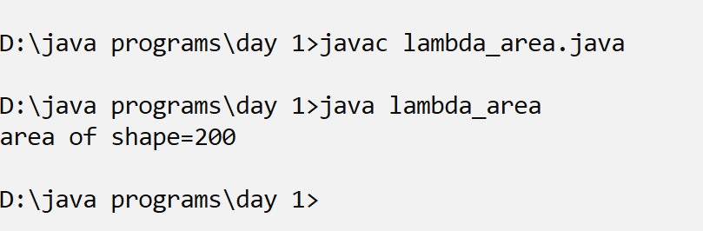
Implementation of area() method from interface shape with lambda
interface shape{
int area(int l,int b);
}
class lambda_area{
public static void main(String [] args){
int l=10;
int b=20;
shape s;
s=(int x,int y)->(x*y);
System.out.println("area of shape="+s.area(l,b));
}
}

Slide 10
/*calculating the euclidean distance using a functional interface */
class dist_main{
public static void main(String [] args){
euclidean e1;
e1=(x1,y1,x2,y2)->Math.sqrt((x1-x2)*(x1-x2)+(y1-y2)*(y1-y2));
System.out.println("The euclidean distance:"+e1.dist(Double.parseDouble(args[0]),Double.parseDouble(args[1]),Double.parseDouble(args[2]),Double.parseDouble(args[3])));
}
}
import java.lang.Math.*;
interface euclidean{
double dist(Double x1,Double x2,Double y1,Double y2);
}

Slide 11
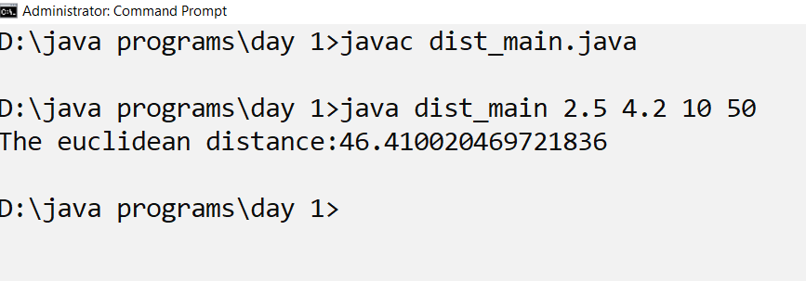
output

Slide 12
Multicasting
interface op{
double math_op(Double x, Double y);
}
class op_main{
public static void main(String [] args){
op o1=(x,y)->(x+y);
System.out.println("The sum of x and y is"+o1.math_op(Double.parseDouble(args[0]),Double.parseDouble(args[1])));
op o2=(x,y)->(x-y);
System.out.println("The difference of x and y is"+o2.math_op(Double.parseDouble(args[0]),Double.parseDouble(args[1])));
op o3=(x,y)->(x*y);
System.out.println("The product of x and y is"+o3.math_op(Double.parseDouble(args[0]),Double.parseDouble(args[1])));
}
}

Slide 13
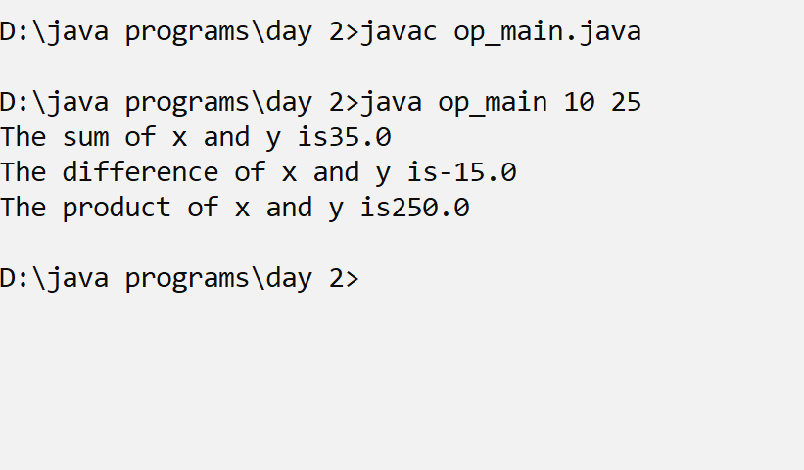
Output

Slide 14
Java Method References
Java provides a new feature called method reference in Java 8.
Method reference is used to refer method of functional interface.
It is compact and easy form of lambda expression.
Each time when you are using lambda expression to just referring a method, you can replace your lambda expression with method reference.

Slide 15
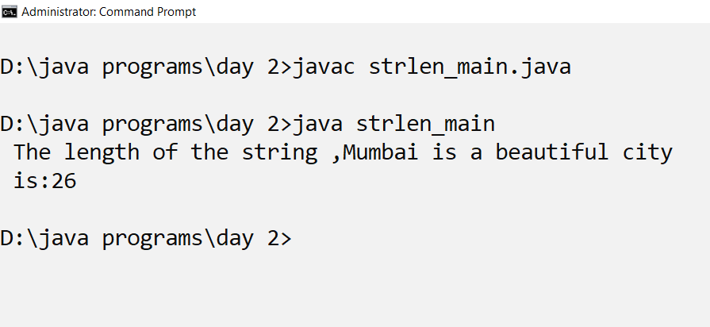
Static method reference
interface len{
int strlen(String x);
}
class strlen_main{
static int strlen_new(String x){
int count=0;
int i=0;
while(x.charAt(i)!='\n'){
i++;
count++;
}
return count;
}
public static void main(String [] args){
len l;
l=strlen_main::strlen_new;
String x="Mumbai is a beautiful city\n";
int length=l.strlen(x);
System.out.println(" The length of the string ," +x + " is:"+length);
}
}

Slide 16
Java Functional Interfaces
An Interface that contains exactly one abstract method is known as functional interface.
It can have any number of default, static methods but can contain only one abstract method.
It can also declare methods of object class.
Functional Interface is also known as Single Abstract Method Interfaces or SAM Interfaces.
It is a new feature in Java, which helps to achieve functional programming approach.

Slide 17
Thank you

